Slide 1
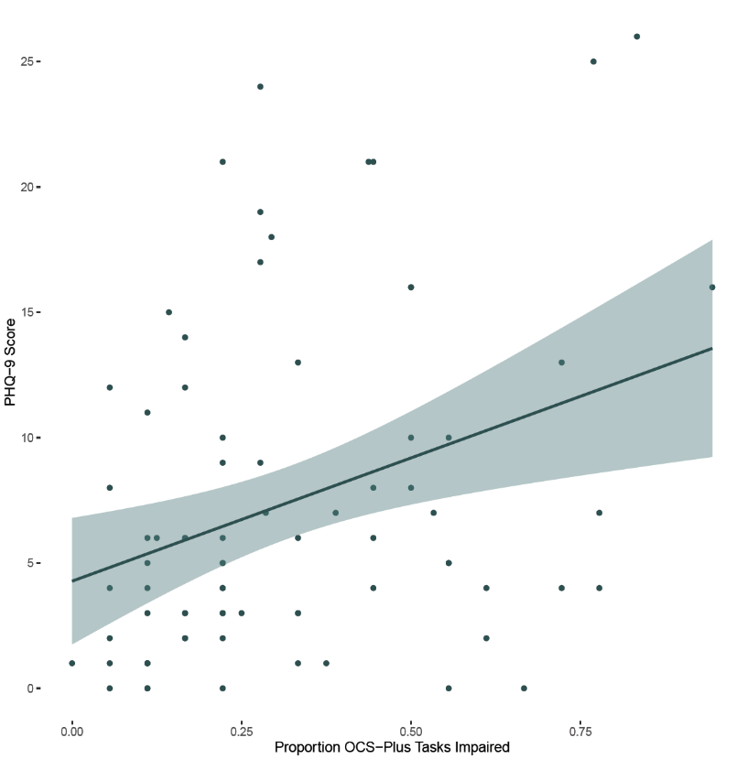
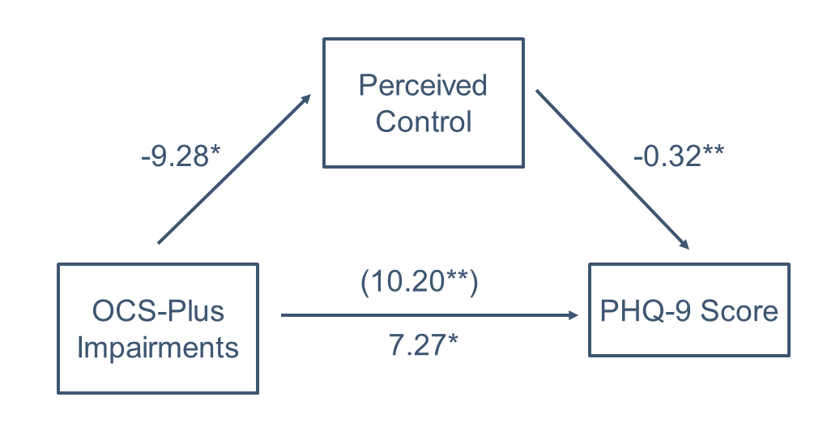
Cognition, Mood and the Role of Illness Perceptions After Stroke
Rebecca Roberts, Dr Reena Vohora, Dr Nele Demeyere
Background
Rates of psychological distress in the post-stroke population are high and have negative implications for ongoing recovery and adjustment.
Post-Stroke Cognitive Impairment (PSCI) predicts depression but the mechanism for this is unclear.
Generally, those who perceive their illness as more threatening and less easy to control are more likely to experience psychological distress.
We explored whether illness perceptions of threat and control mediate the relationship between PSCI and depression after stroke.
Cognitive Impairment Significantly Predicted Depressive Symptoms
Perceptions of control were predicted by degree of cognitive impairment (ꞵ=-9.28, p=.04) and predictive of depressive symptoms (ꞵ=-0.32, p<.01).
Perceptions of control partially mediated the relationship between PSCI and depressive symptoms (p=.04).
Threat perceptions were important predictors of depression (ꞵ=0.18, p<.01) but were not predicted by PSCI.
PHQ-Score
Impairments on OCS-Plus
Methods
Participants
We recruited 77 stroke survivors in the sub-acute phase after stroke (M = 36 days since stroke).
Average age 73 (SD=13), education 14 years (SD=3), 46% female, 88% ischemic stroke, acute NIHSS = 8 (SD=6), 24% past MH difficulties.
Materials
All participants completed:
Oxford Cognitive Screen Plus (OCS-Plus)
Patient Health Questionnaire (PHQ-9)
Generalised Anxiety Disorder Assessment (GAD-7)
Stroke Revised Illness Perception Questionnaire (Stroke IPQ-R)
The Barthel Index for Daily Living
Results
Conclusions
99% of the sample showed impairment in at least one subtest of the OCS-Plus.
28% were considered to have at least mild depression and 21% at least mild anxiety.
Cognitive Impairment was not a significant predictor of anxiety when depressive symptoms were included in the model.
Illness perceptions are important in understanding why some people with PSCI develop depression.
Perceptions of control, in particular, might explain the relationship between PSCI and mood after stroke.
Our findings are similar to recent dementia research showing locus of control is important for mood.
This is a modifiable target for intervention in the sub-acute phase after stroke.
Contact
rebecca.roberts@hmc.ox.ac.uk
TRANSLATIONAL
NEUROPSYCHOLOGY
GROUP

